Slide 1
Robust Cloud Segmentation in Satellite Images using Multi-view Learning
Rushan Mukherjee 7015520

Slide 2
Agenda
Introduction
Methodology
Results
Discussion

Slide 3
Introduction

Slide 4
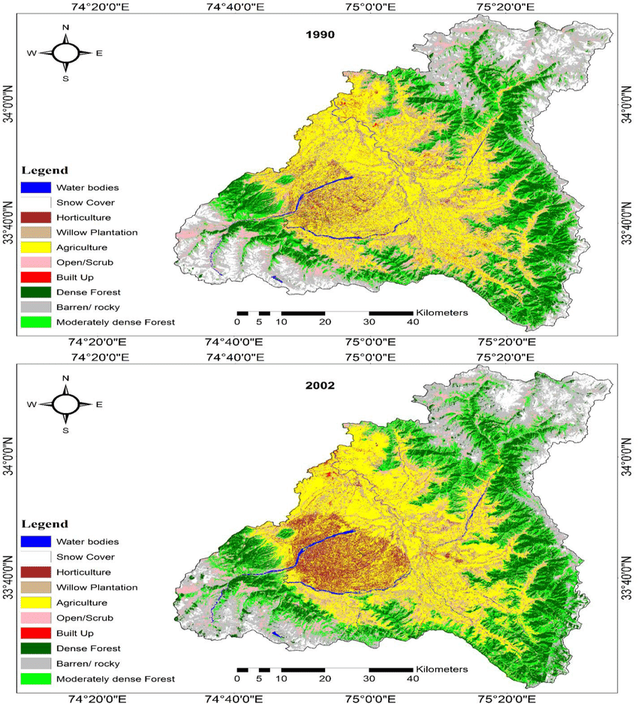
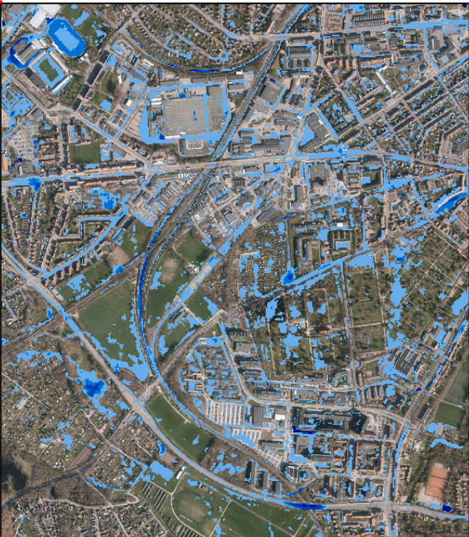
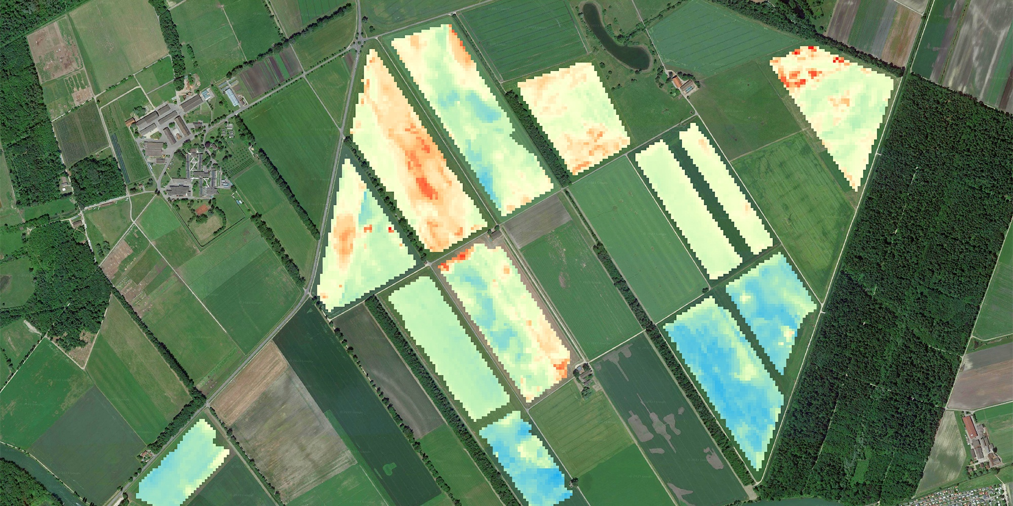
Why Cloud Segmentation ?
LULC
Flood Depth Prediction
Crop Yield Prediction

Slide 5
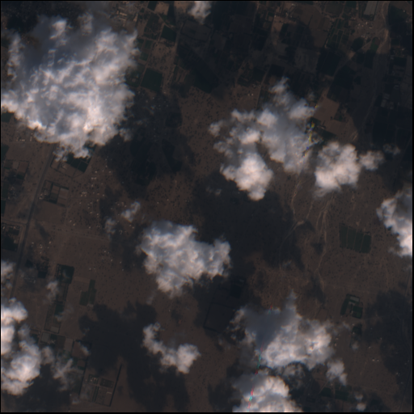
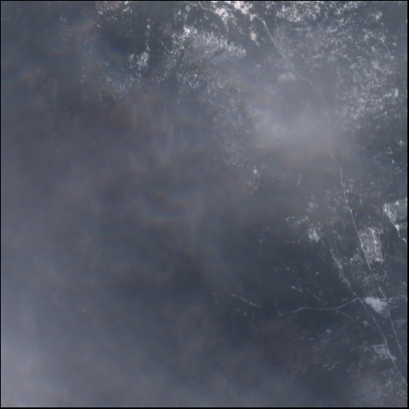
Why Cloud Segmentation ?

Slide 6
Traditional Cloud Segmentation
Hand-crafted algorithms
Threshold based approaches
Thresholds vary as per season, sun elevation, deserts, fog/haze, and ice/snow cover.
No common solution
Specific thresholds for clouds over water, clouds over snow.

Slide 7
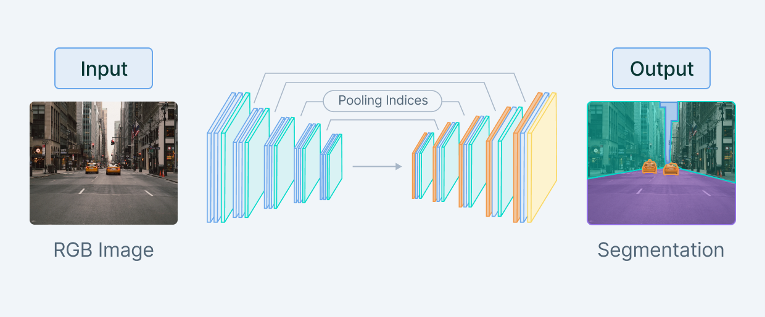
Cloud Segmentation using Deep Learning

Slide 8



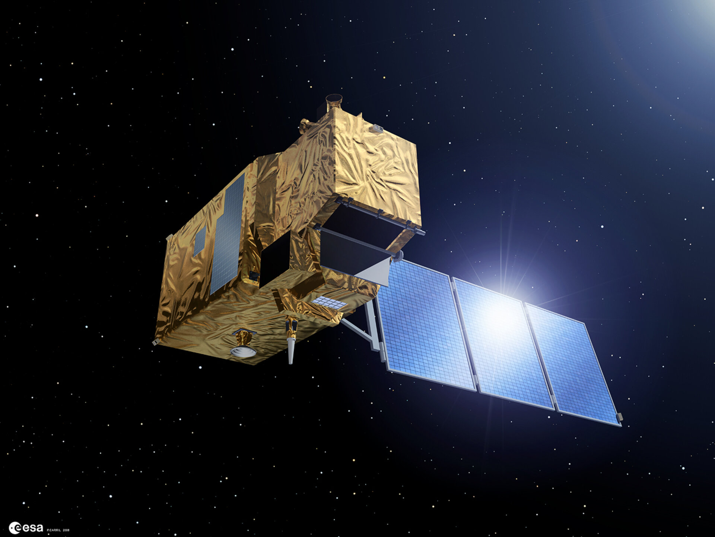
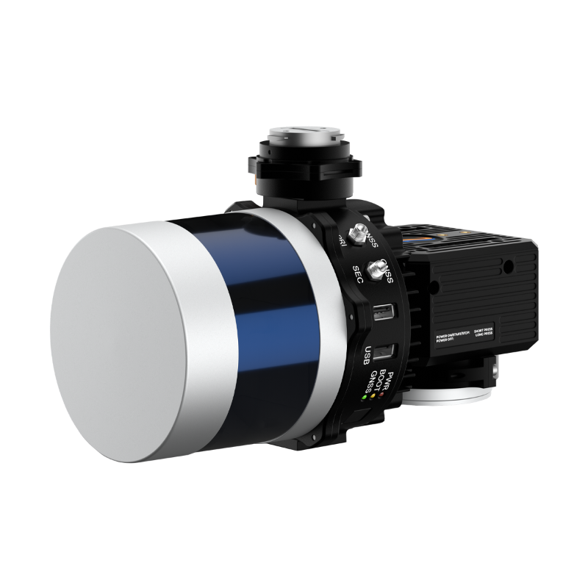
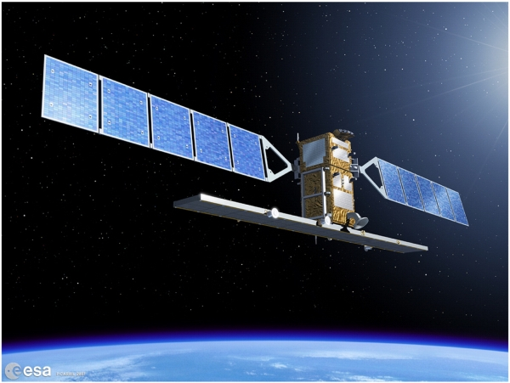
Multi-View Learning
Audio
Video
Text
Optical
LIDAR
Synthetic Aperture Radar

Slide 9
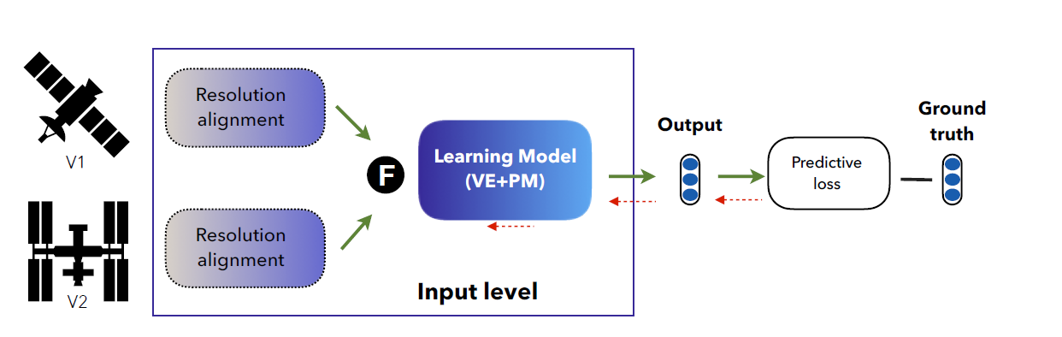
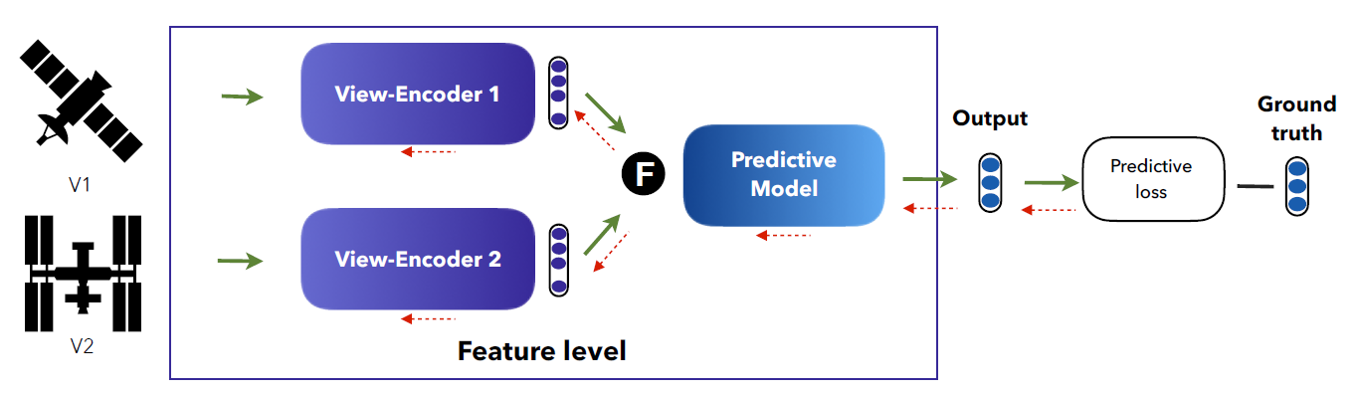
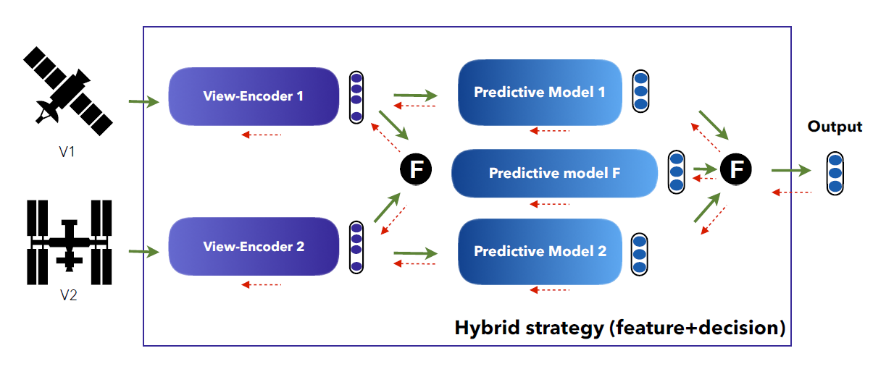
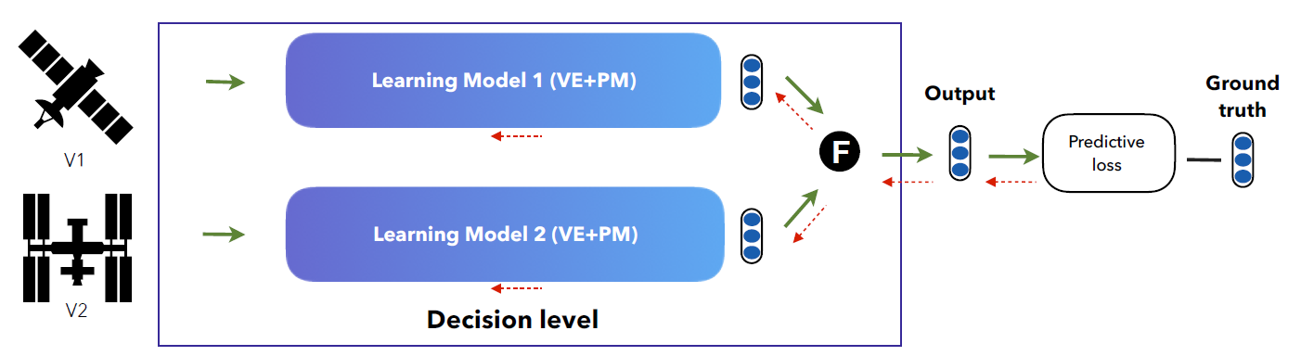
How to Fuse ?

Slide 10
METHODOLOGY

Slide 11
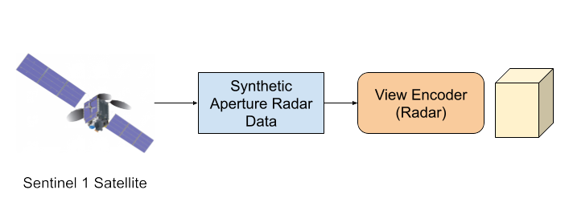
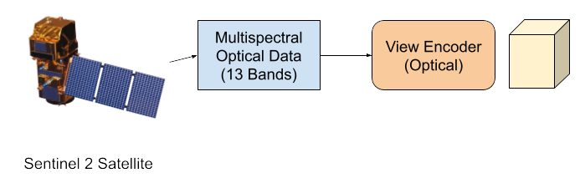
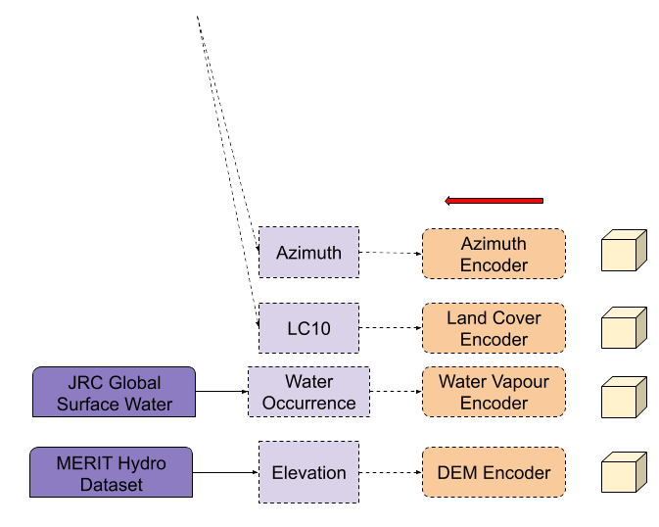
Proposed Model 1 – Multi-View Fusion

Slide 12
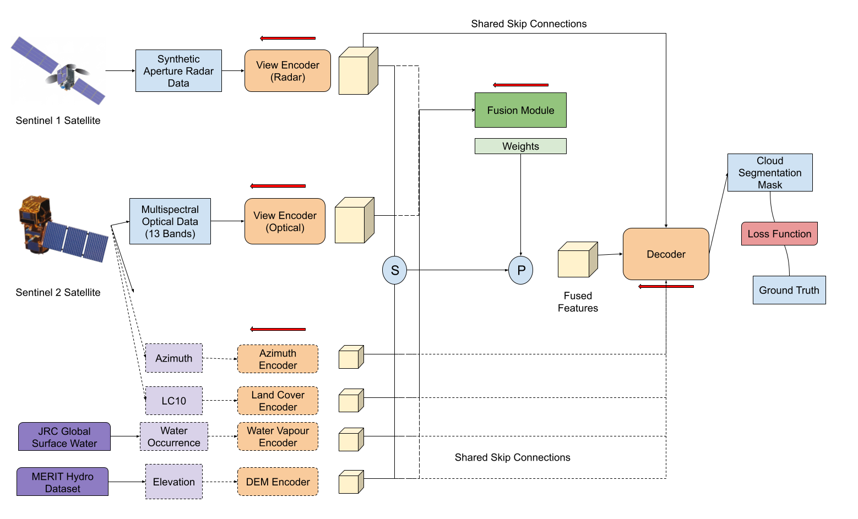
Proposed Model 1 – Multi-View Fusion

Slide 13
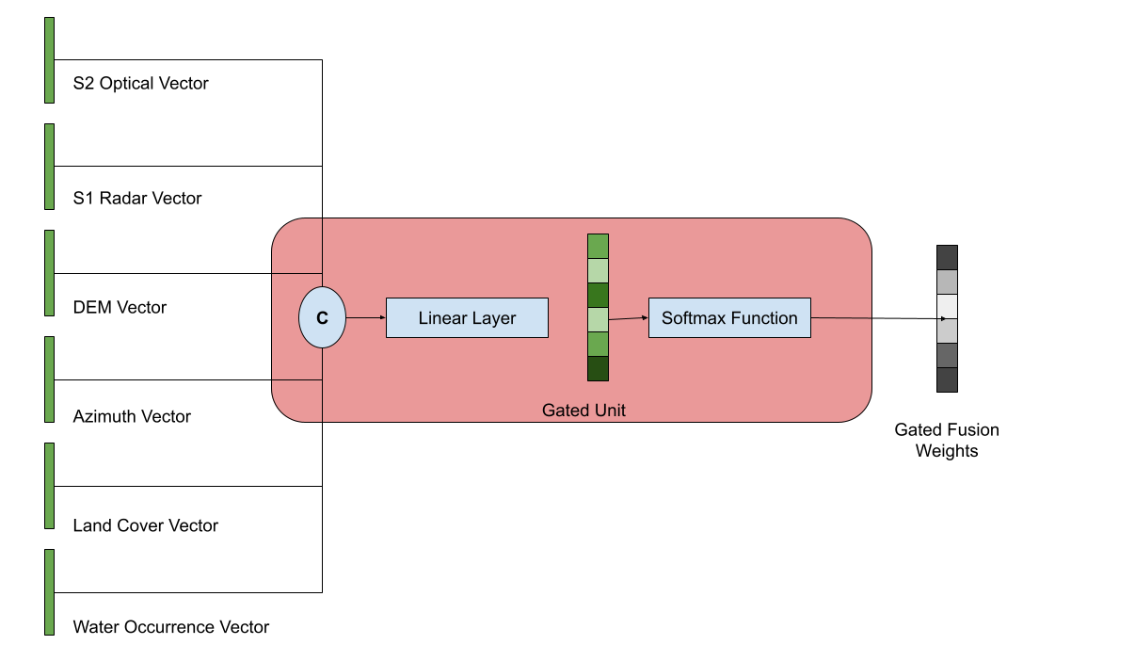
Proposed Model – Gated Fusion

Slide 14
Validation Dataset – Cloudsen12
Global cloud and cloud shadow segmentation benchmarking dataset.
2000 unique Regions of Interest(ROI)
Each ROI has 5 cloud coverage types
Cloud free, Almost-clear(0-25%), Low-Cloudy(25-45%), Mid-Cloudy(45-65%), Cloudy(>65%).
Spatial resolution: 5090x5090 meters
Image sizes: 512x512 pixels
3 types of annotation: High-quality human annotated, scribble and no annotation.

Slide 15
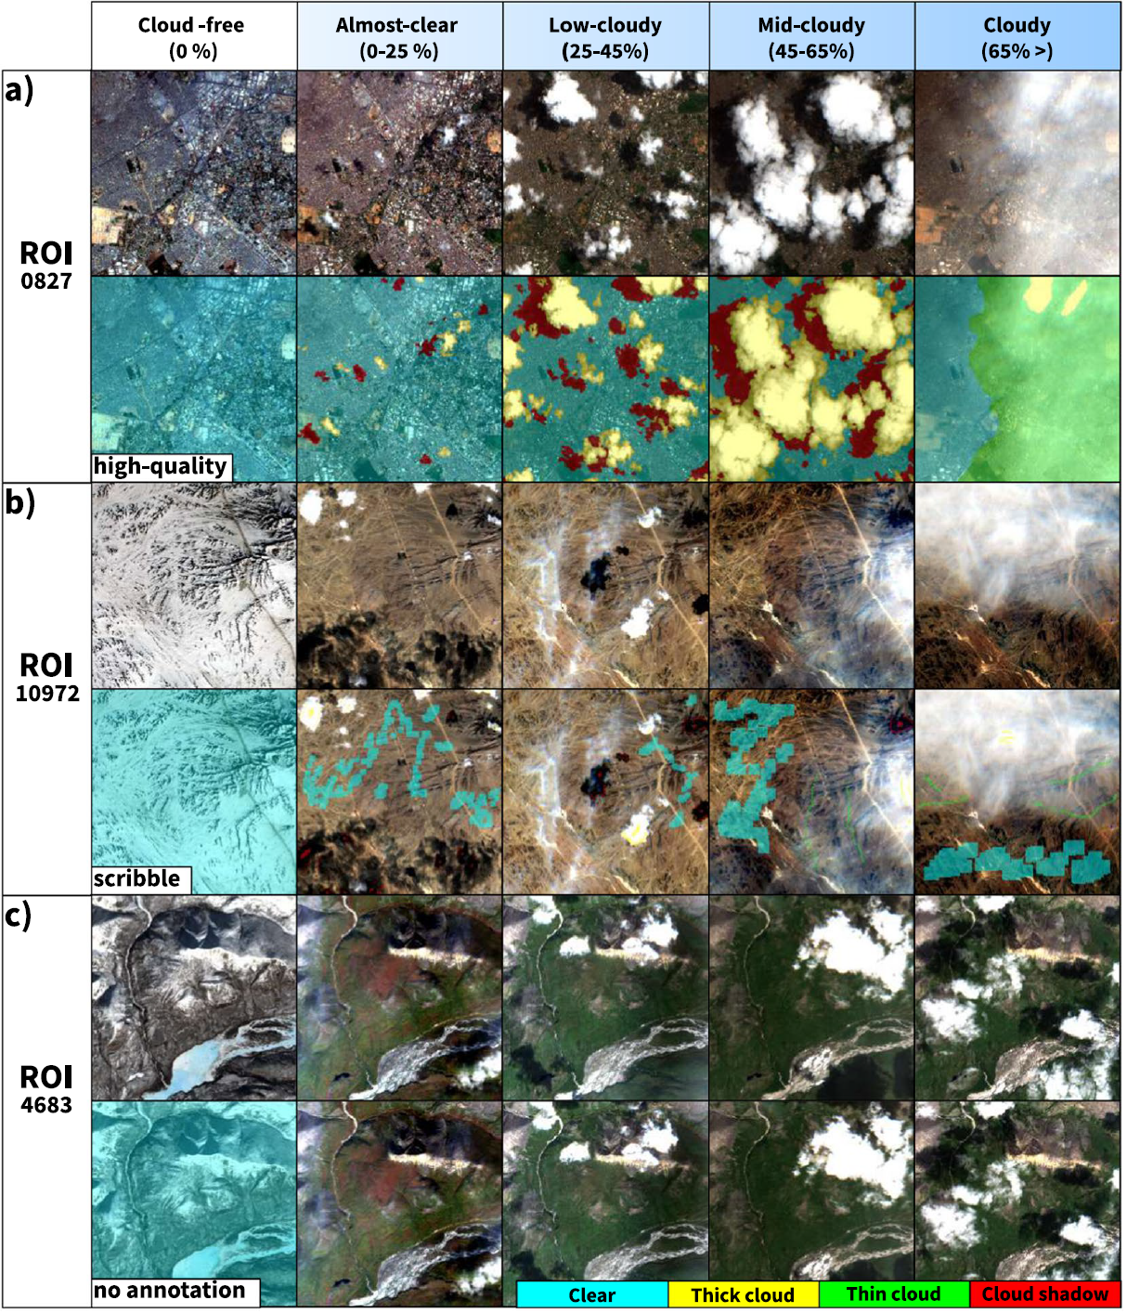
Validation Dataset – Cloudsen12
4 output classes
Clear
Thick cloud
Thin cloud
Cloud shadow

Slide 16
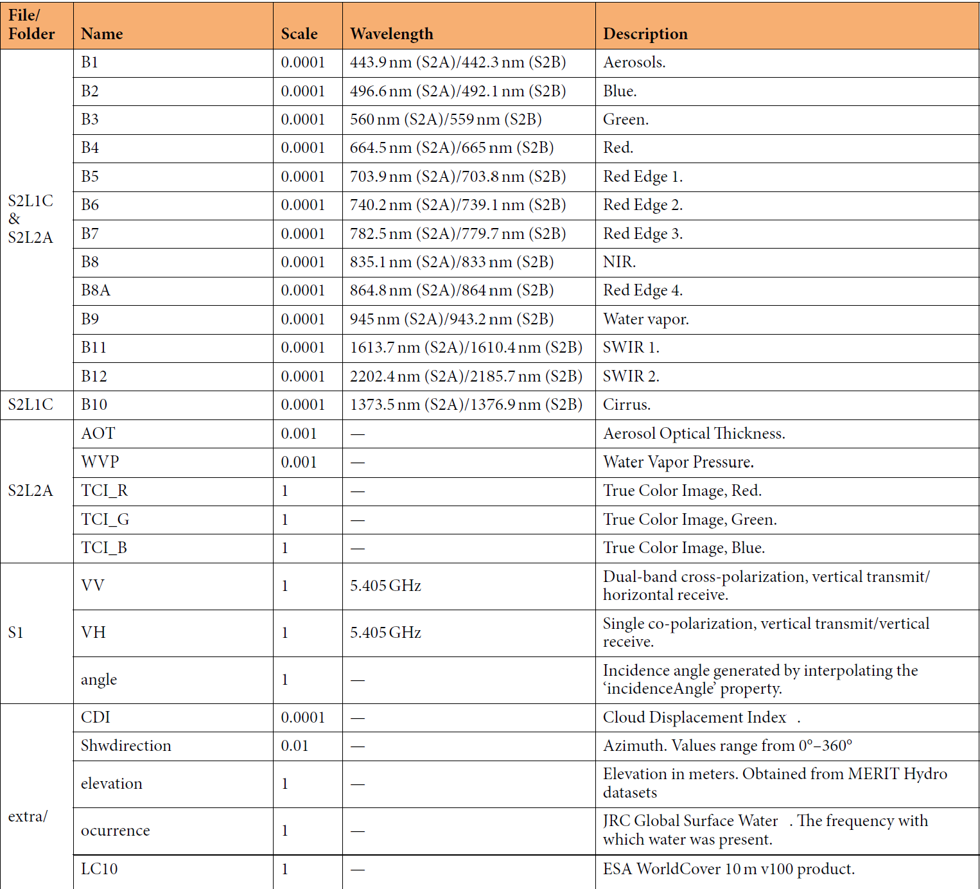
Validation Dataset – Cloudsen12

Slide 17
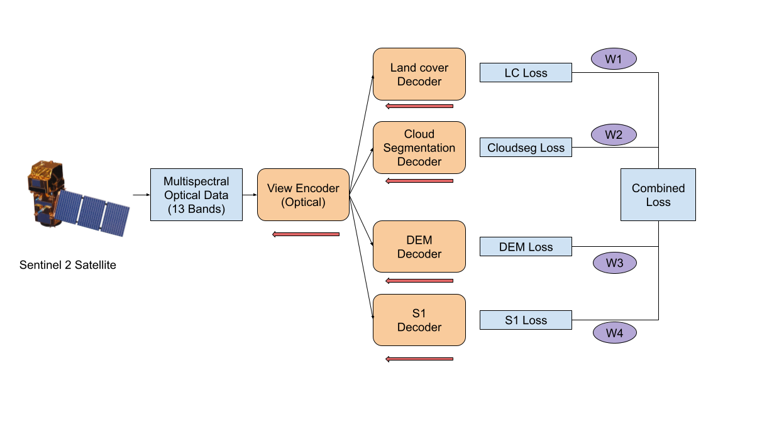
Proposed Model 2 – Pretext Task

Slide 18
RESULTS

Slide 19
Proposed Models’ Performance
Model | Fusion | Accuracy | Precision | Recall | F1Score
Sen2Cor | - | 0.49 | 0.59 | 0.49 | 0.45
KappaMask | - | 0.52 | 0.58 | 0.52 | 0.50
Sentinel 1 | - | 0.25 | 0.13 | 0.25 | 0.17
Sentinel 2 | - | 0.65 | 0.70 | 0.65 | 0.63
2 Modality | Concatenation | 0.67 | 0.72 | 0.67 | 0.69
2 Modality | Gated | 0.66 | 0.72 | 0.66 | 0.66
All Modality | Concatenation | 0.69 | 0.77 | 0.69 | 0.72
All Modality | Gated | 0.66 | 0.74 | 0.66 | 0.68
Sentinel 2 Pretext | - | 0.61 | 0.60 | 0.67 | 0.61

Slide 20
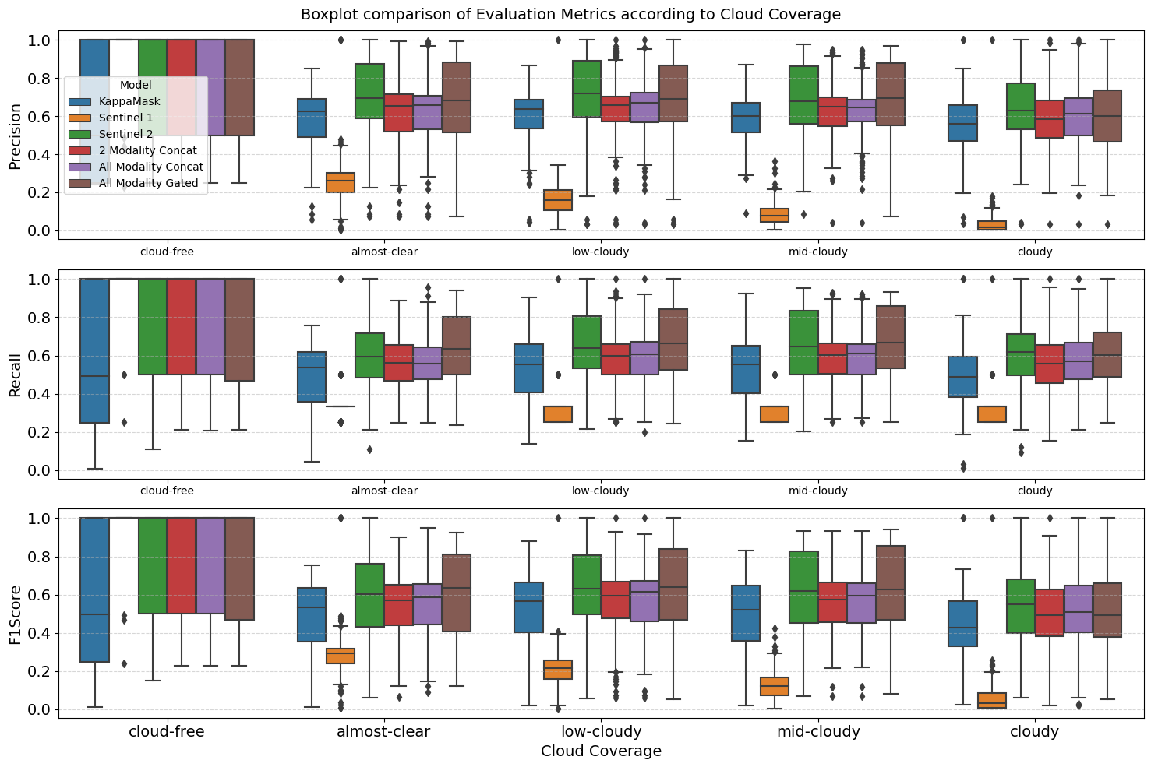

Slide 21
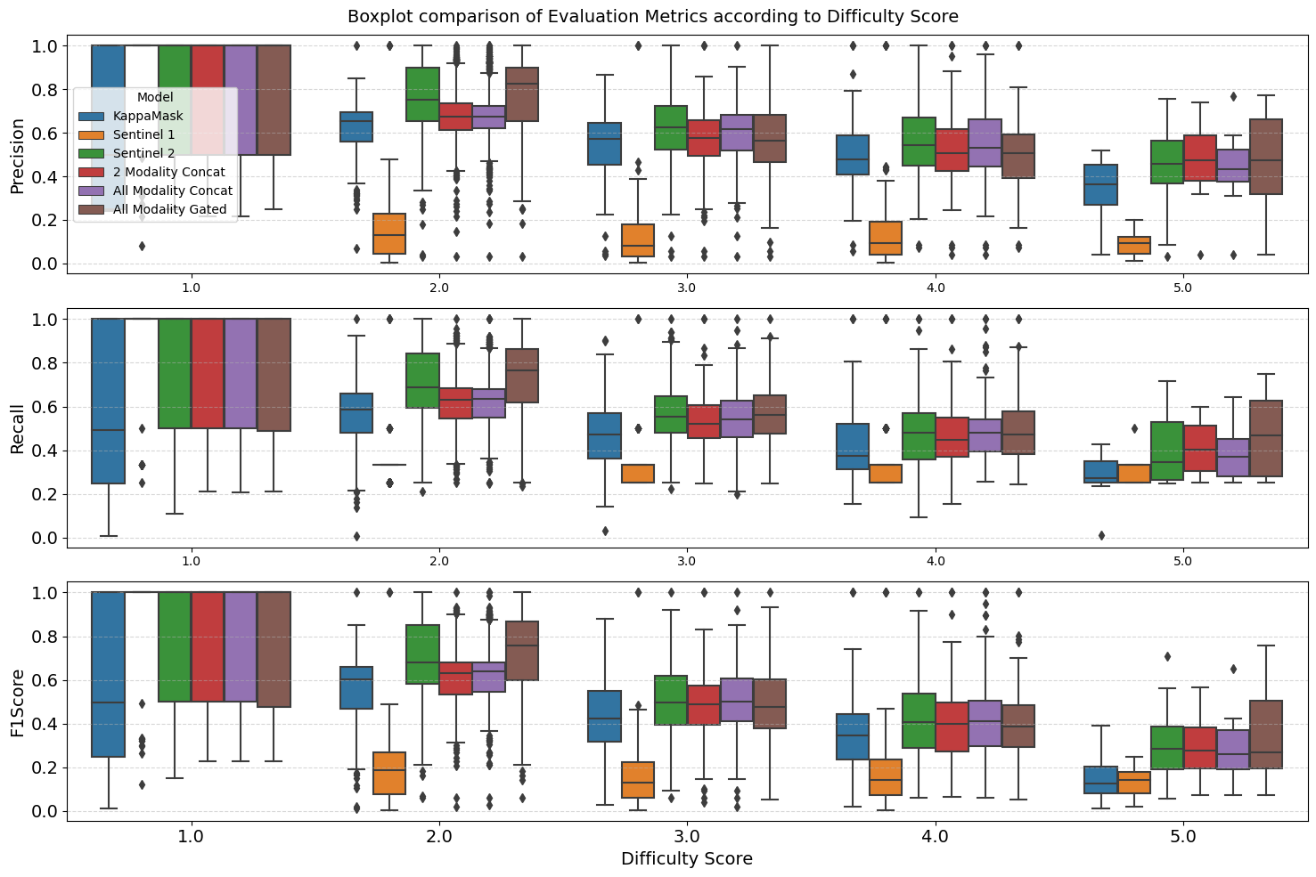

Slide 22
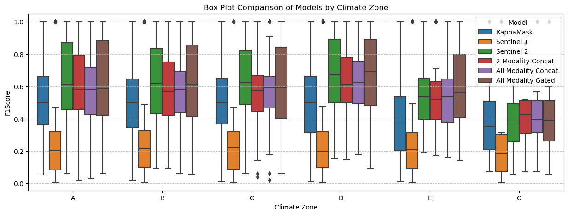
Koeppen-Geiger Climatic Zones Comparison

Slide 23
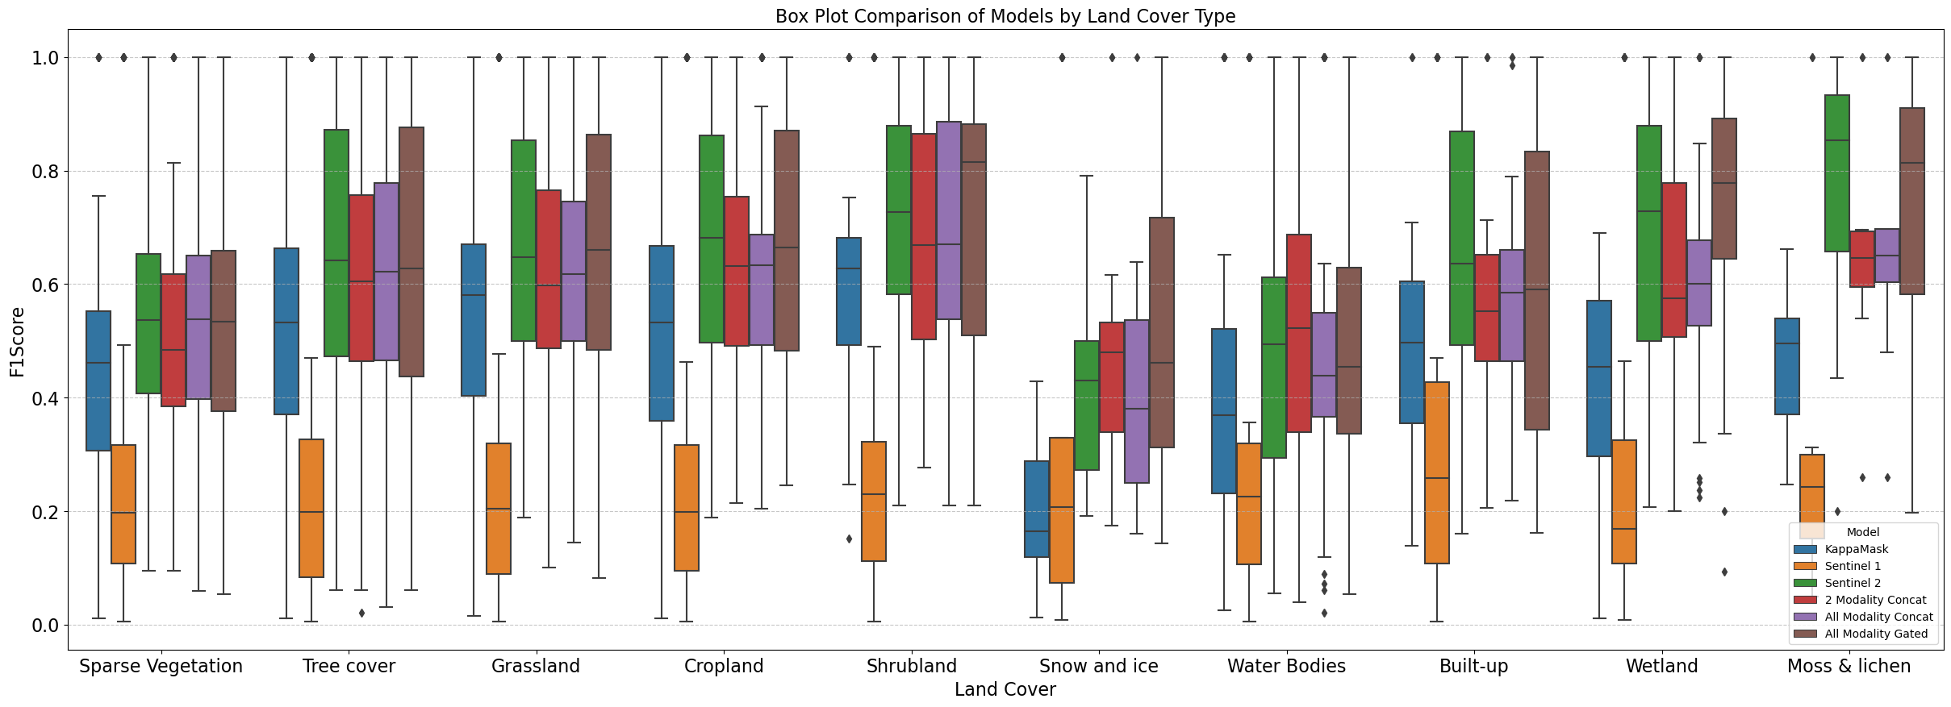
Image Wise Land Cover Comparison

Slide 24
Band Removal Experiment - RECAP

Slide 25
Band Removal Experiment – All Modality Gated
Bands Removed | Band Name | Accuracy | F1Score | MeanIOU | Precision | Recall
0 | - | 0.66 | 0.68 | 0.41 | 0.74 | 0.66
1 | Aerosol | 0.45 | 0.44 | 0.25 | 0.46 | 0.45
2 | Blue | 0.45 | 0.44 | 0.25 | 0.46 | 0.45
3 | Green | 0.29 | 0.20 | 0.28 | 0.33 | 0.29
4 | Red | 0.25 | 0.11 | 0.28 | 0.32 | 0.25
5 | Red Edge 1 | 0.25 | 0.11 | 0.28 | 0.32 | 0.25
6 | Red Edge 2 | 0.45 | 0.40 | 0.22 | 0.43 | 0.45
7 | Red Edge 3 | 0.49 | 0.41 | 0.31 | 0.53 | 0.49
8 | NIR | 0.34 | 0.27 | 0.28 | 0.32 | 0.34
9 | Red Edge 4 | 0.26 | 0.13 | 0.29 | 0.37 | 0.26
10 | Water Vapour | 0.43 | 0.32 | 0.31 | 0.36 | 0.43
11 | Cirrus | 0.39 | 0.37 | 0.28 | 0.45 | 0.39
12 | SWIR 1 | 0.25 | 0.12 | 0.28 | 0.34 | 0.25

Slide 26
Band Removal Experiment – All Modality Concat
Bands Removed | Band Name | Accuracy | F1Score | MeanIOU | Precision | Recall
0 | - | 0.69 | 0.72 | 0.43 | 0.77 | 0.69
1 | Aerosol | 0.31 | 0.20 | 0.31 | 0.35 | 0.31
2 | Blue | 0.31 | 0.20 | 0.31 | 0.35 | 0.31
3 | Green | 0.25 | 0.11 | 0.28 | 0.31 | 0.25
4 | Red | 0.25 | 0.11 | 0.28 | 0.31 | 0.25
5 | Red Edge 1 | 0.25 | 0.11 | 0.28 | 0.31 | 0.25
6 | Red Edge 2 | 0.39 | 0.24 | 0.31 | 0.34 | 0.39
7 | Red Edge 3 | 0.40 | 0.22 | 0.33 | 0.39 | 0.40
8 | NIR | 0.25 | 0.12 | 0.28 | 0.33 | 0.25
9 | Red Edge 4 | 0.41 | 0.22 | 0.34 | 0.43 | 0.41
10 | Water Vapour | 0.37 | 0.30 | 0.31 | 0.60 | 0.37
11 | Cirrus | 0.26 | 0.14 | 0.28 | 0.27 | 0.26
12 | SWIR 1 | 0.30 | 0.22 | 0.30 | 0.50 | 0.30

Slide 27
CONCLUSION

Slide 28
Conclusion
Multi-view learning potentially better method for cloud and cloud shadow segmentation.
Extra modalities on top of Sen1 and Sen2 useful.
Not yet robust to data loss scenario.

Slide 29
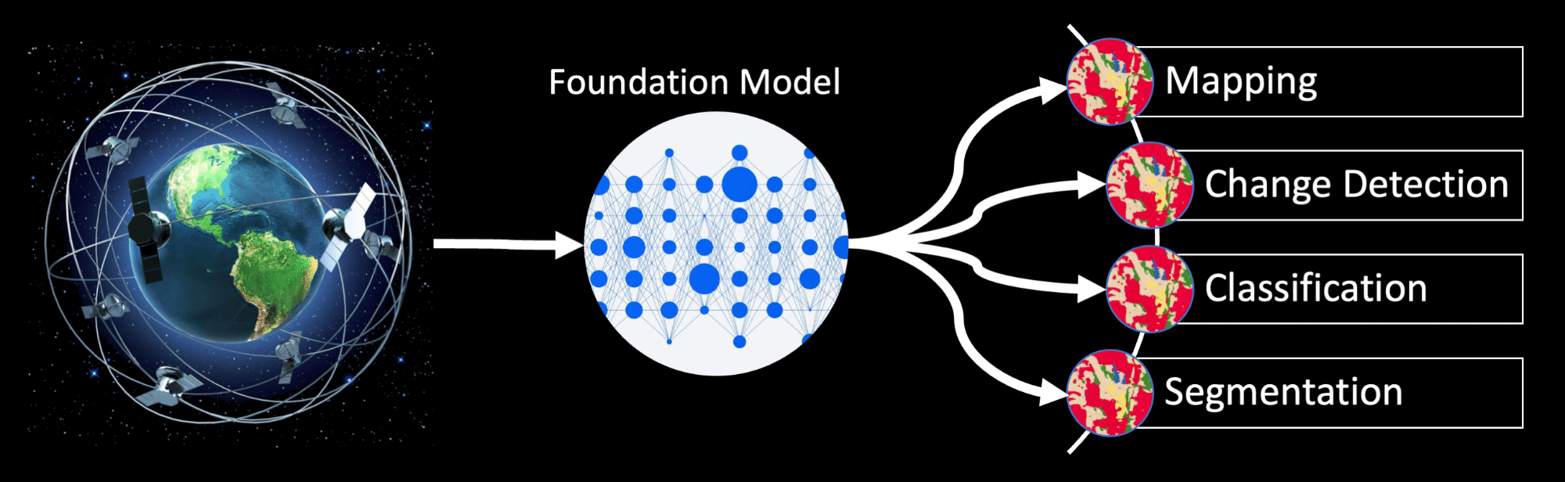
Future Work
Better method of fusion needed.
Model complexity needs to be increased.
Attention mechanisms might help.
Multi-view model to Geospatial Foundation Model.

Slide 30
THANK YOU

Slide 31
APPENDIX

Slide 32
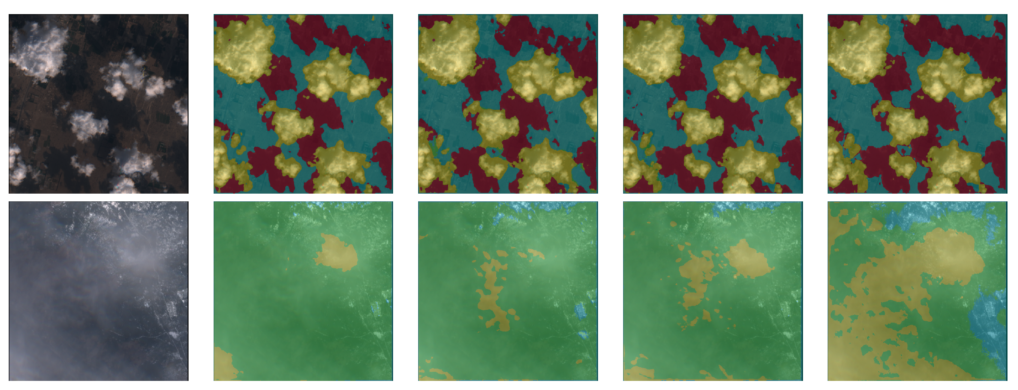
Side by Side Model Comparison
Sen1+ Sen2
Concatenation
All Modality
Concatenation
All Modality
Gated
RGB
Sentinel 2

Slide 33
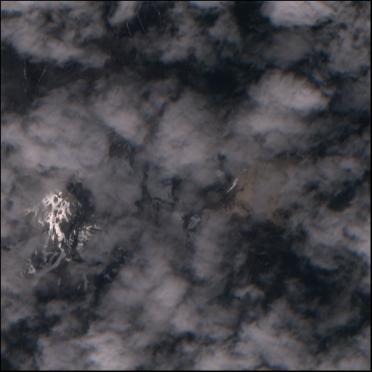
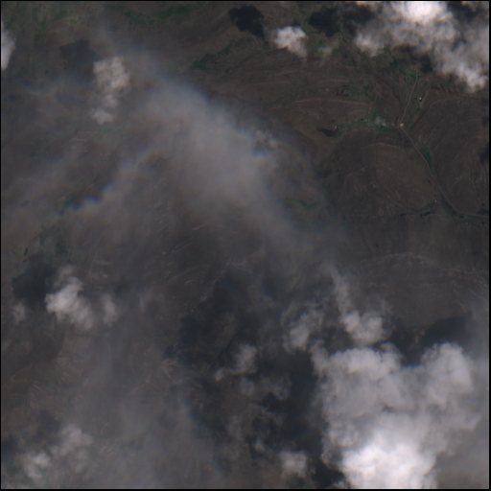
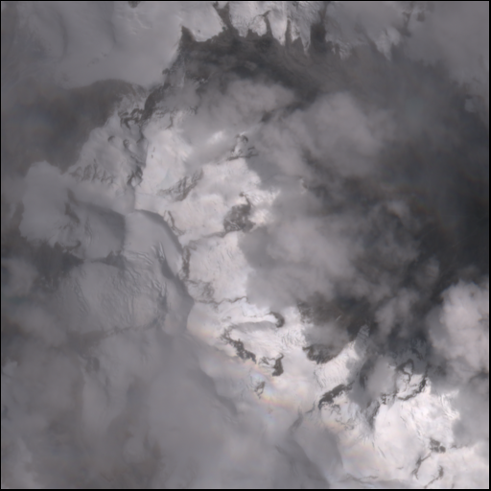
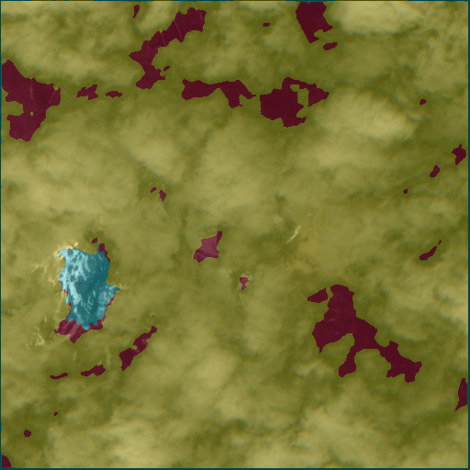
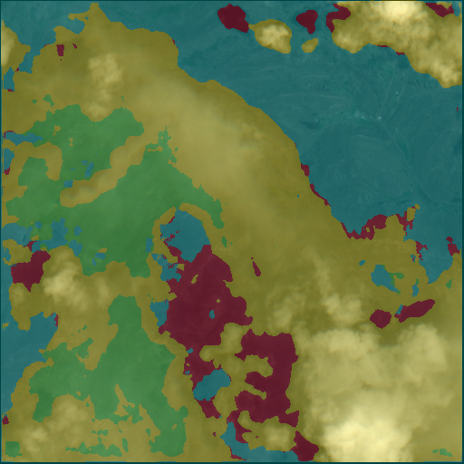
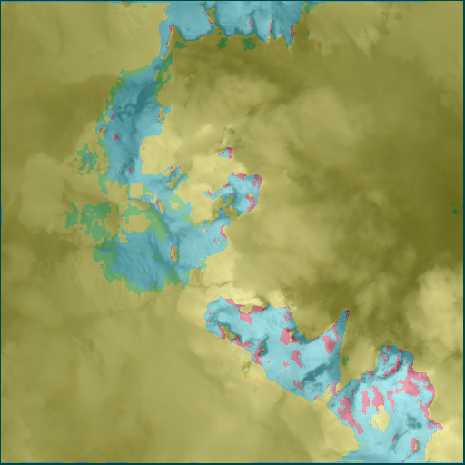
Polar Climate Cloudy

Slide 34
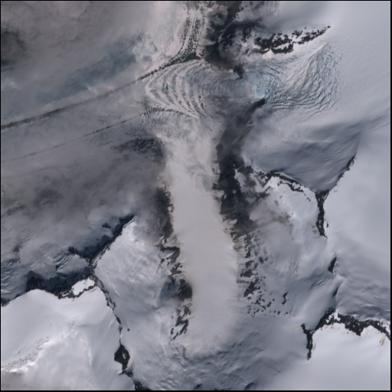
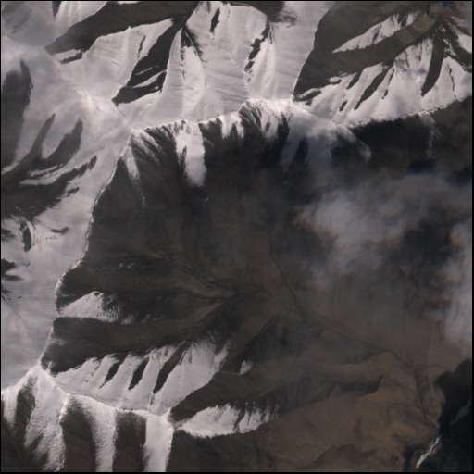
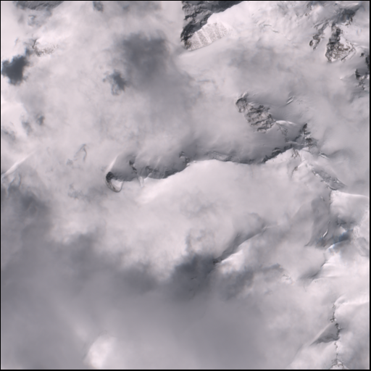
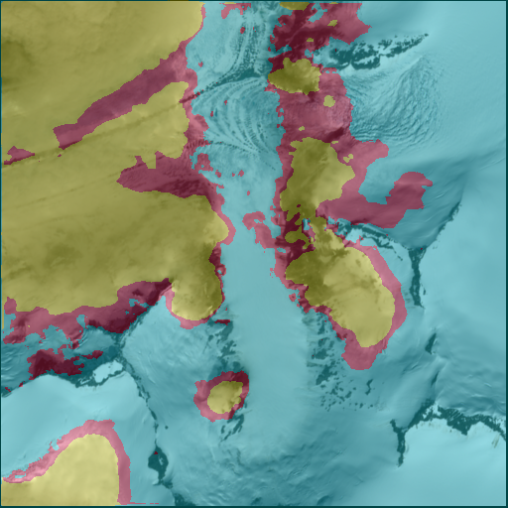
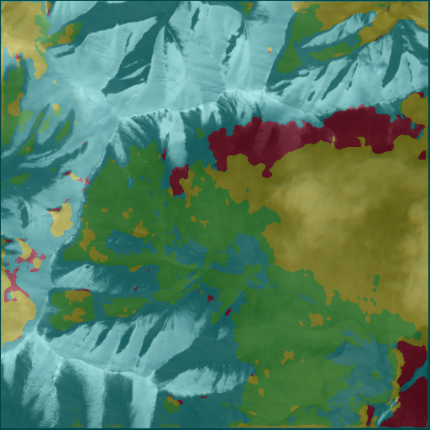
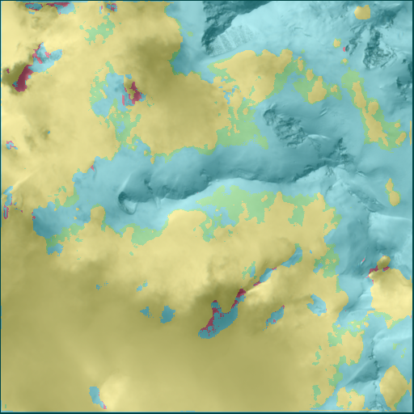
Polar Climate Low Cloudy

Slide 35
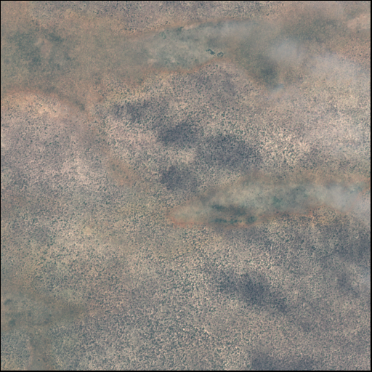
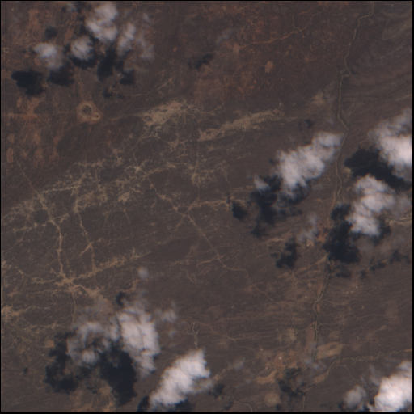
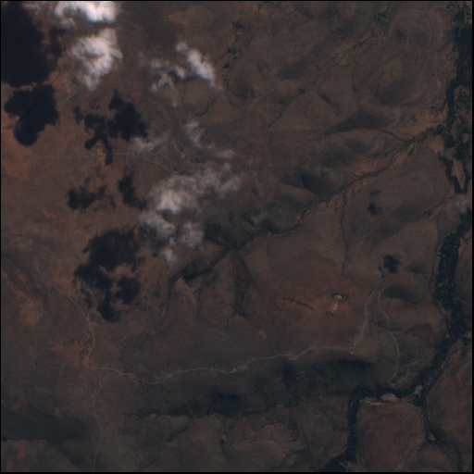
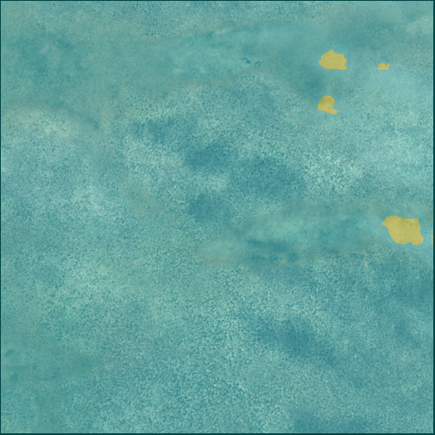
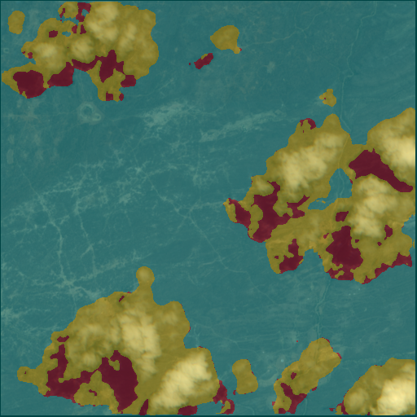
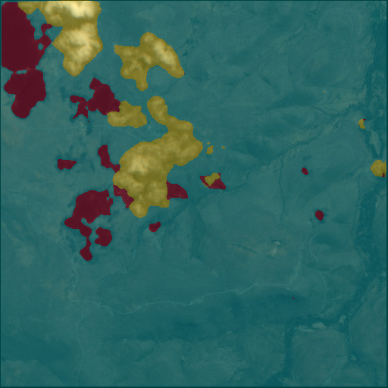
Shrub Vegetation/Land Cover Low Cloudy

Slide 36
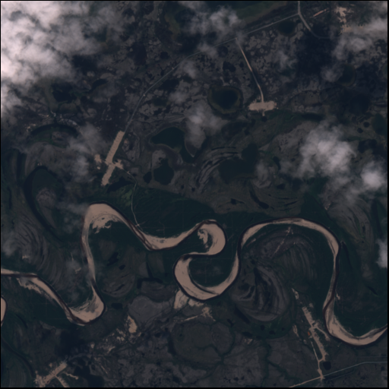
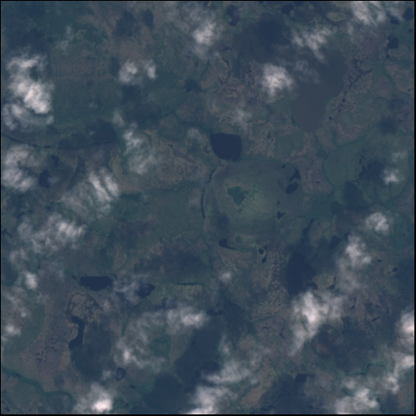
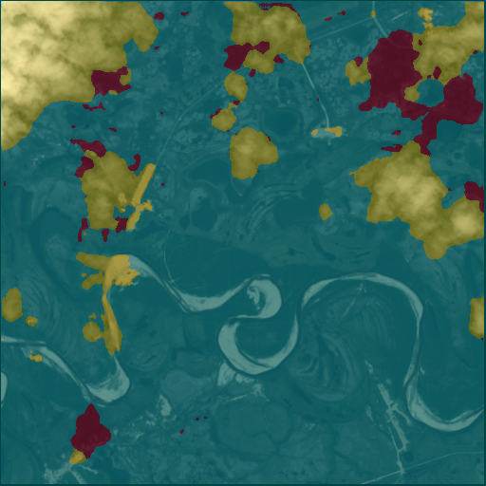
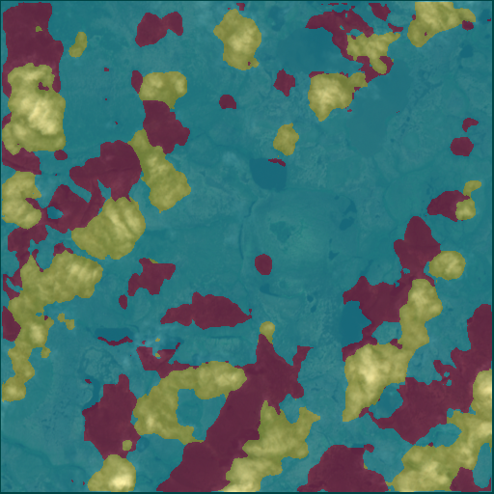
Wetland Type Landcover Low Cloudy

Slide 37
Training Details
Learning Rate(LR): 0.0001
Optimizer: Adam
Num Epochs: 50
Weight Decay: 1e-5
Batch Size: 16
Gradient Accumulation: 4
Loss Function: Cross Entropy Loss

Slide 38
UNet Details
Activation Function : Rectified Linear Unit (ReLU)
Pooling Operation: Maxpool2d
Upsampling Operation: Nearest Upsampling
Batch Normalization: Yes
Bias: Yes

Slide 39
Ablation Studies - Dropout
Model | Dropout | Validation Loss
AMG | N/A | 0.558
AMG | 10% | 0.771
AMG | 20% | 1.530
AMG | 30% | 1.512
AMG | Adaptive | 0.553
Adaptive Dropout
ENCODER = Layer 1(10%), Layer 2(10%), Layer 3(20%), Layer 4(20%), Layer 5(30%)
DECODER = Layer 1(30%), Layer 2(20%), Layer 3(20%), Layer 4(10%)

Slide 40
Ablation Studies – Batch Size
Model | Batch Size | Gradient Accumulation | Effective Batch Size | Validation Loss
AMG with Adaptive Dropout | 16 | 2 Steps | 32 | 0.553
“ | 16 | 4 Steps | 64 | 0.552
“ | 16 | 8 Steps | 128 | 0.96
Effective Batch Size = Gradient Accumulated Batches

Slide 41
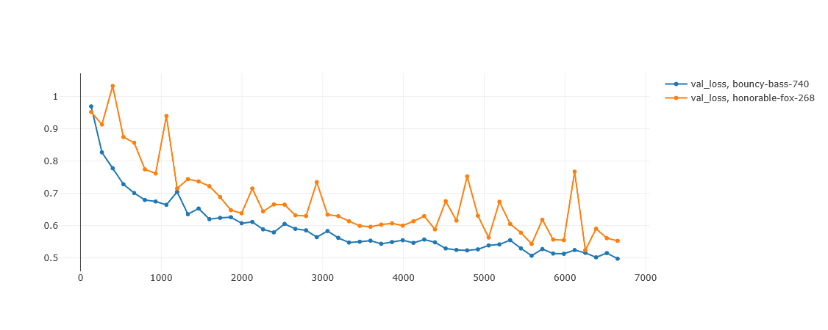
Ablation Studies – Learning Rate
Model | Learning Rate | Validation Loss | Accuracy | Precision | Recall | F1Score
AMG with Adaptive Dropout | 0.0001 | 0.497 | 0.674 | 0.749 | 0.674 | 0.694
“ | 0.001 | 0.552 | 0.610 | 0.751 | 0.610 | 0.647

Slide 42

Ablation Studies – Loss Function
Model | Loss Function | Validation Loss | Accuracy | Precision | Recall | F1Score
AMG with Adaptive Dropout | Cross Entropy Loss | 0.497 | 0.674 | 0.749 | 0.674 | 0.694
“ | Dice Loss | 0.216 | 0.551 | 0.574 | 0.551 | 0.537
$Dice Score\left(Ytrue, Ypred\right)=2 ∗\frac{|Ytrue ∩YPred|}{\left|Ytrue\right|+|Ypred|}$
$$Dice Loss=1 −Dice Score(Ytrue, Ypred)$$

Slide 43
Ablation Studies - Others
Model | Changes | Validation Loss | Accuracy | Precision | Recall | F1Score
AMG with Adaptive Dropout | N/A | 0.497 | 0.674 | 0.749 | 0.674 | 0.694
“ | Leaky ReLU | 0.492 | 0.656 | 0.772 | 0.656 | 0.683
“ | Bilinear Upsampling | 0.512 | 0.571 | 0.669 | 0.571 | 0.560
“ | No Bias | 0.497 | 0.638 | 0.756 | 0.638 | 0.655

Slide 44
Ablation Studies - Others
Model | Test Loss | Accuracy | Precision | Recall | F1Score | MeanIOU
AMG with Adaptive Dropout | 0.495 | 0.658 | 0.747 | 0.658 | 0.680 | 0.418
No S1 gated | 0.496 | 0.610 | 0.739 | 0.610 | 0.618 | 0.402
No S1 concat | 0.514 | 0.624 | 0.733 | 0.624 | 0.633 | 0.402

Slide 45

SOTA Model Performance

Slide 46

Difficulty Score of Training Images as per Annotators

Slide 47

Time Difference in Image Capture

Slide 48

Pixel Count

